Slide 1
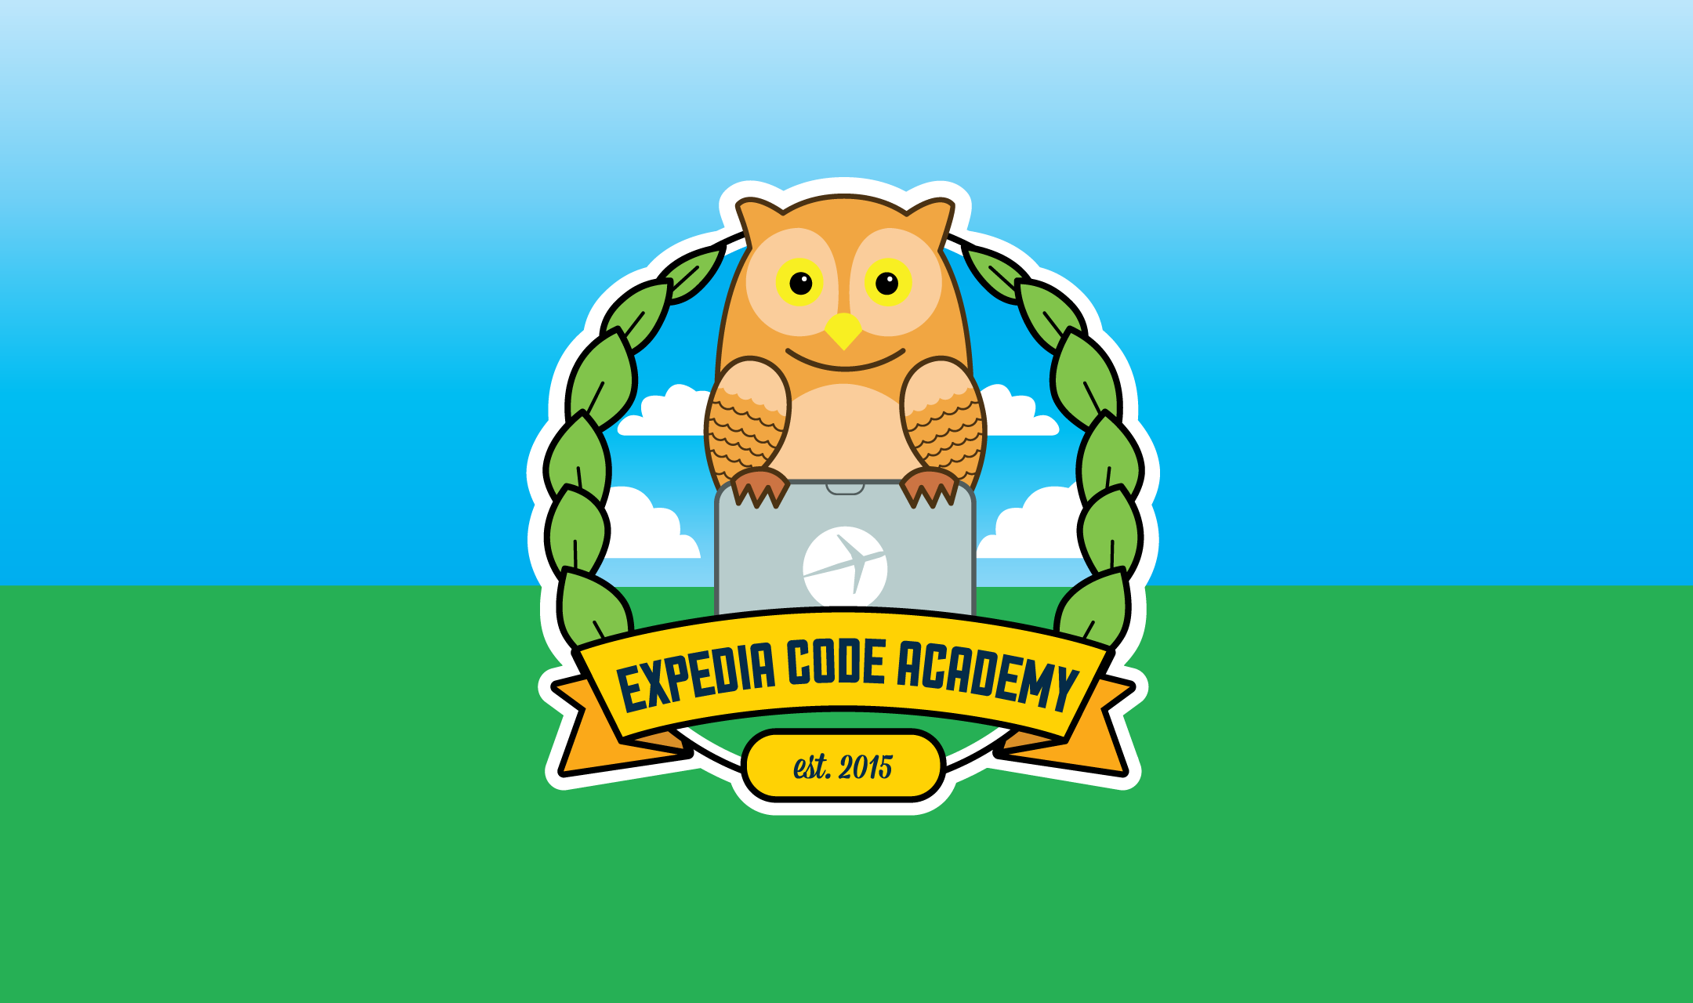
Python Level 2
882.33
Lesson 4: Getting to know JSON

Slide 2
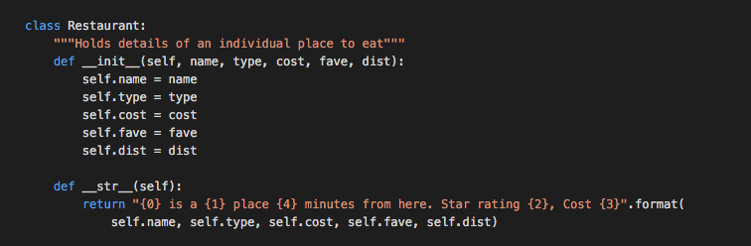

Last week

Slide 3
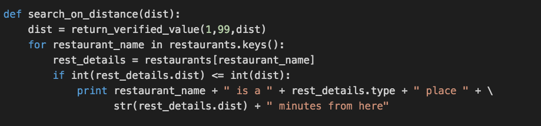
Last week (continued)

Slide 4
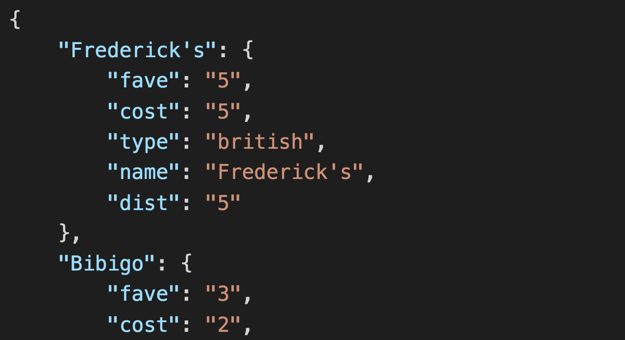
And now for something completely different…
What is this?

Slide 5
JSON: JavaScript Object Notation
Common form of data encoding
Allows us to create more complex data structures than CSV
Uses similar data structures to Python:
Strings
Integers and floats
Lists
Dictionaries
Let’s all start with the same base code:
http://go/enkjc8f9

Slide 6
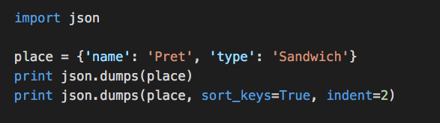
Getting to know JSON

Slide 7
…But wait, what?
We can save or print a dictionary as a JSON object.
What about a Restaurant? Try it now!

Slide 8

…But wait, what?
We can save or print a dictionary as a JSON object.
But not an arbitrary class (like Restaurant)
Let’s add a method to class Restaurant to convert it to a dictionary:

Slide 9
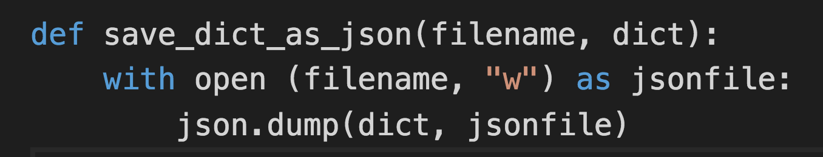
Interacting with files

Slide 10
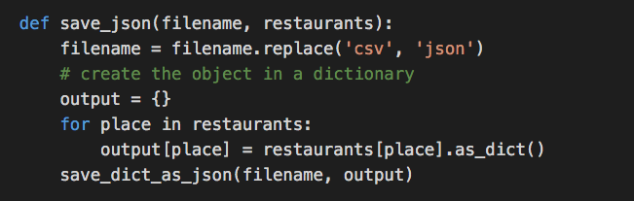
Now we can save as JSON or CSV

Slide 11
Exercise/Homework…
Make changes to your program so that it will load and save either
JSON
CSV
pydoc json may well give you a hint here
Next week we’ll be using JSON in an different way.
Questions? Comments? Come see us in S32, on Monday, 11:00 – 12:00

